Slide 1


SplitNN: Single-Machine Network Emulation at Scale with Minute-Level Construction of 10K-Node Virtual Networks
Kaifei Peng, Yanbiao Li, Wenbin Li, Xian Yu, Gaogang Xie
Notes:
Good morning everyone. I'm Kaifei Peng from Chinese Academy of Sciences. Today, I’m glad to present our work on large-scale network emulation

Slide 2
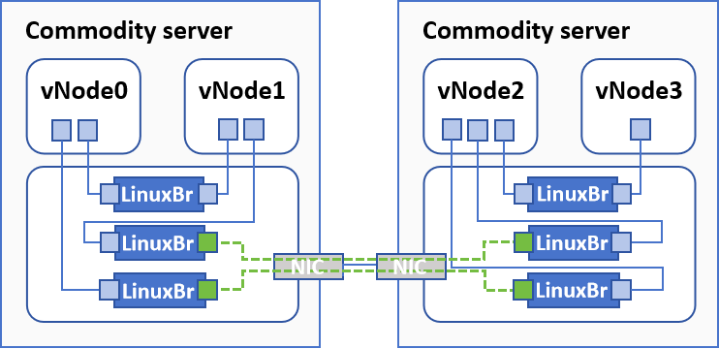

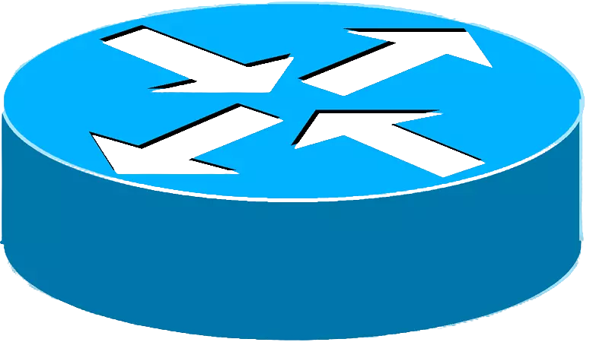
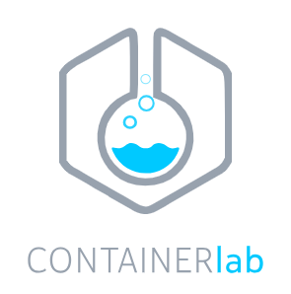
Network Emulation
A critical paradigm for evaluating novel network technologies
Pros: Realism and practicality
real-world network
virtual network
Notes:
Network emulation is a crucial and widely-used methodology for evaluating new network technologies.
Compared to other methods, such as event-driven simulators and hardware testbeds, network emulation strikes a balance between realism and practicality by constructing virtual networks that resemble real-world environments.
Recently, there are two main demands for network emulation.

Slide 3


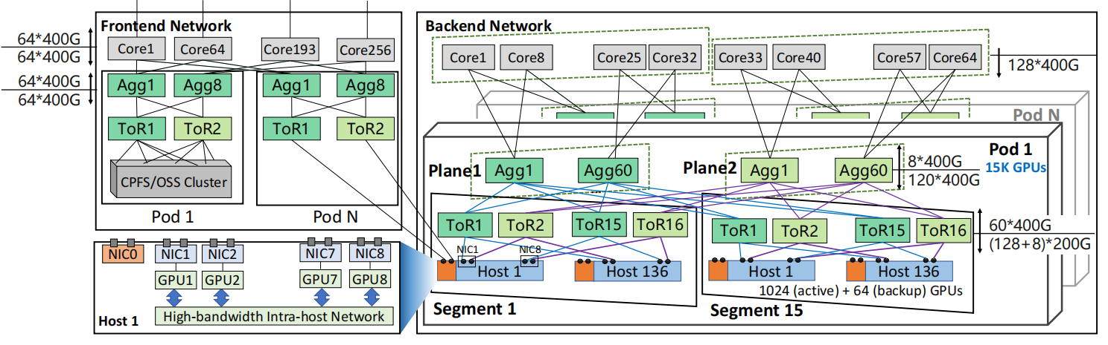
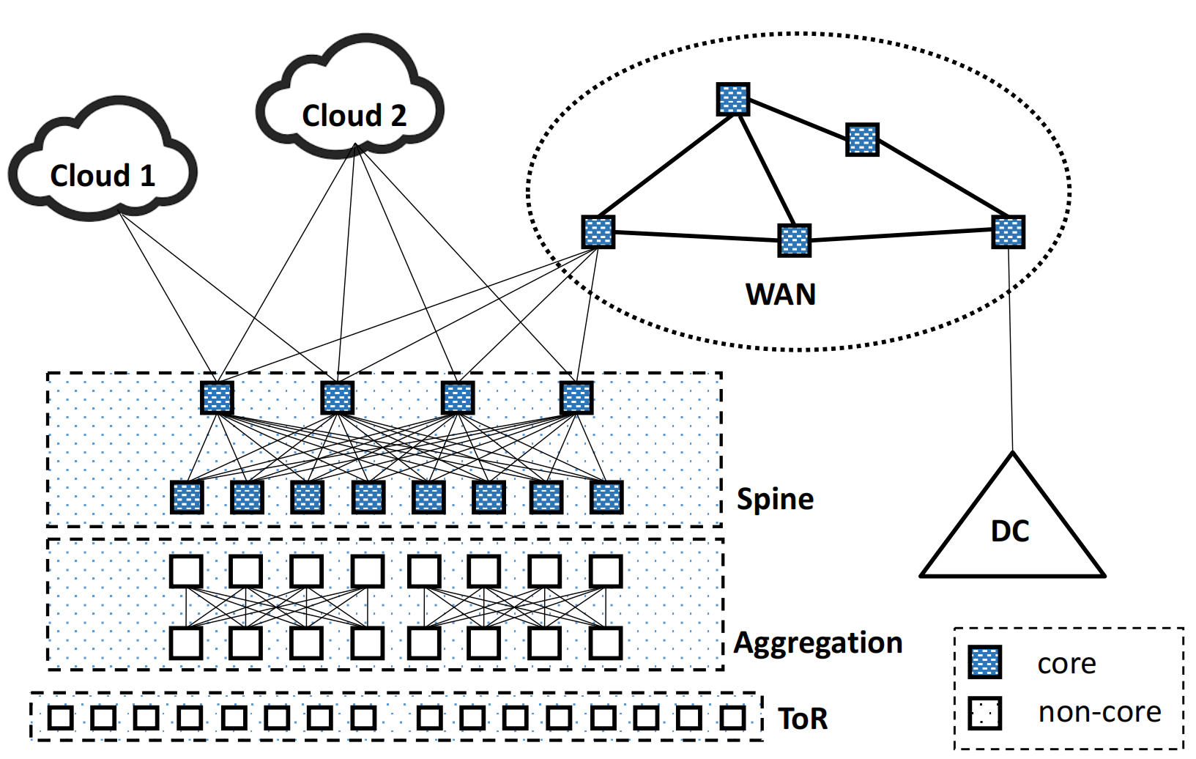
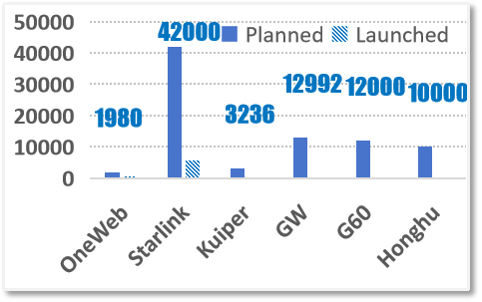
Scalability Demand of Network Emulation
LEO satellite networks
Global BGP AS network
Data center networks
[2] HPN (SIGCOMM ’24)
[3] Cresent (NSDI ’24)
10K-40K+ nodes
76K+ nodes
1K-10K+ nodes
Demand #1: construct virtual networks of 10K-node scale
[1] https://dailygalaxy.com/2024/12/elon-musk-starlink-lets-iphones-and-androids-call-anywhere-on-earth/
[2] Kun Qian, Yongqing Xi, Jiamin Cao, Jiaqi Gao, Yichi Xu, Yu Guan, Binzhang Fu, Xuemei Shi, Fangbo Zhu, Rui Miao, Chao Wang, Peng Wang, Pengcheng Zhang, Xianlong Zeng, Eddie Ruan, Zhiping Yao, Ennan Zhai, and Dennis Cai. 2024. Alibaba HPN: A Data Center Network for Large Language Model Training. In Proceedings of the ACM SIGCOMM 2024 Conference (ACM SIGCOMM '24). Association for Computing Machinery, New York, NY, USA, 691–706. https://doi.org/10.1145/3651890.3672265
[3] Zhaoyu Gao, Anubhavnidhi Abhashkumar, Zhen Sun, Weirong Jiang, and YiWang. 2025. Crescent: Emulating Heterogeneous Production Network at Scale. In21st USENIX Symposium on Networked Systems Design and Implementation (NSDI ’24). USENIX Association, Santa Clara, CA, 1045–1062. https://www.usenix.org/conference/nsdi24/presentation/gao-zhaoyu
Notes:
The first is the scalability demand, which is driven by emergence of large-scale networks listed here.
Emulating these large-scale networks requires network emulators to construct virtual networks of ten-thousand-node scale.

Slide 4
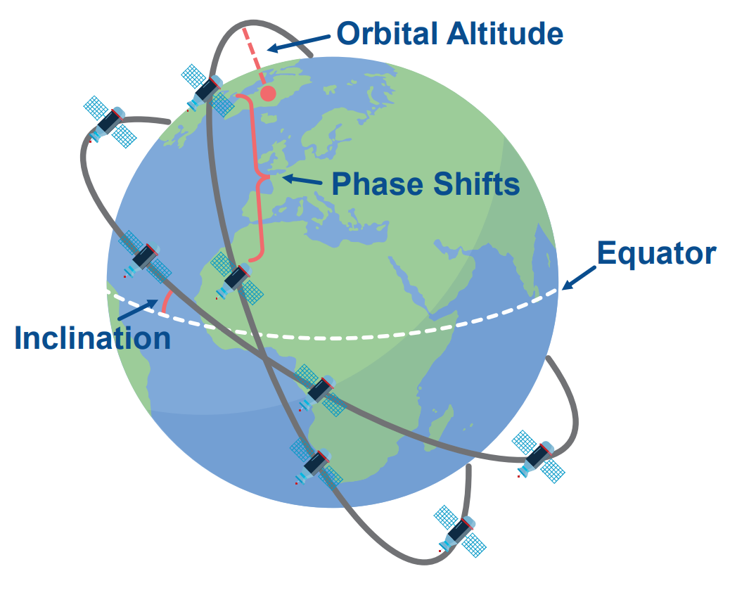
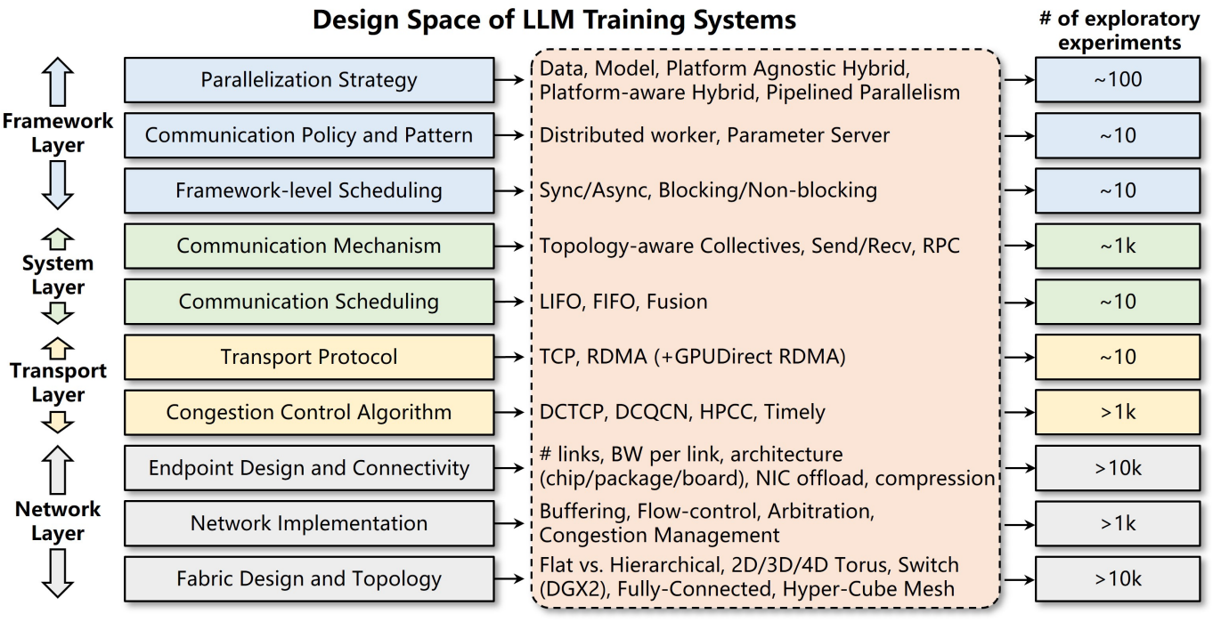
Efficiency Demand of Network Emulation
LEO Constellation Design
LLM Cluster Design
LEO constellation parameters [1]
Design space of LLM training clusters [2]
Hundreds/thousands of possible network system design
Hundreds/thousands of experiments
[1] Fei Gui, Kaihui Gao, Li Chen, Dan Li, Vincent Liu, Ran Zhang, Hongbing Yang, and Dian Xiong. 2025. Accelerating Design Space Exploration for LLM Training Systems with Multi-experiment Parallel Simulation. In 22nd USENIX Symposium on Networked Systems Design and Implementation (NSDI 25). USENIX Association, Philadelphia, PA, 473–488. https://www.usenix.org/conference/nsdi25/presentation/gui
[2] Wenyi Zhang, Zihan Xu, and Sangeetha Abdu Jyothi. 2024. An In-Depth Investigation of LEO Satellite Topology Design Parameters. In Proceedings of the 2nd International Workshop on LEO Networking and Communication (Washington, DC, USA) (LEO-NET ’24). Association for Computing Machinery, New York, NY, USA, 1–6. https://doi.org/10.1145/3697253.3697263
Notes:
The second is efficiency. Modern network innovation and optimization tends to explore thousands of design choices.
When using network emulation, it is needed to execute thousands times of experiments to fully explore these design spaces.

Slide 5
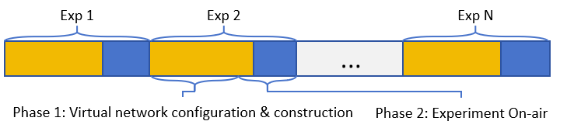
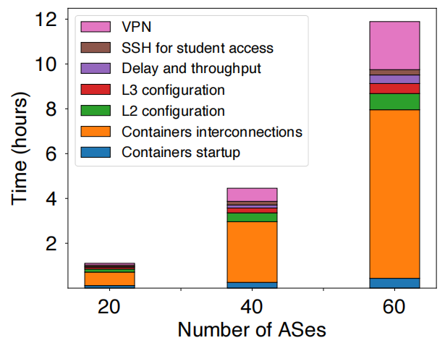
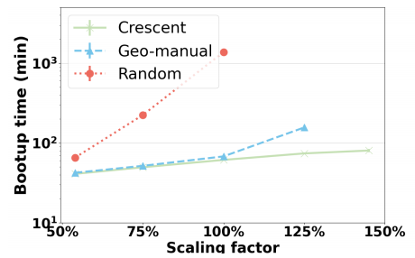
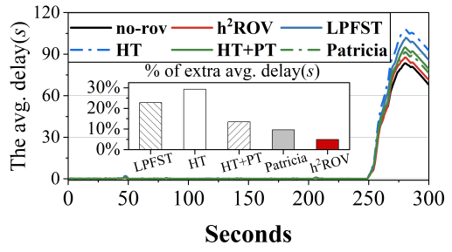
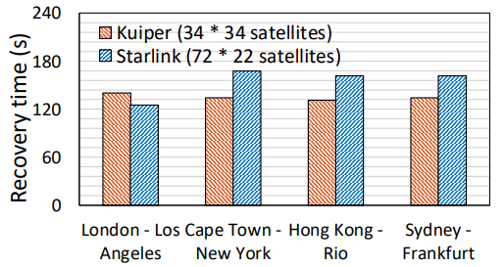

Efficiency Demand of Network Emulation
Problem: virtual network construction hinders overall experiment efficiency
Long VN construction time
Short experiment time
Urgent need: faster VN construction
[1]
[2]
[4]
vs.
[3]
Experiments on-air time (traffic replay, routing re-convergence) often take several minutes only
Virtual network (VN) construction takes multi-ten minutes or even hours
Shorter time
i.e. Better efficiency
Demand #2: construct virtual networks faster
[1] Thomas Holterbach, Tobias Bü, Tino Rellstab, and Laurent Vanbever. 2020. An Open Platform to Teach How the Internet Practically Works. SIGCOMM Comput. Commun. Rev. 50, 2 (April 2020), 45–52. https://doi.org/10.1145/3402413.3402420
[2] Zhaoyu Gao, Anubhavnidhi Abhashkumar, Zhen Sun, Weirong Jiang, and YiWang. 2025. Crescent: Emulating Heterogeneous Production Network at Scale. In21st USENIX Symposium on Networked Systems Design and Implementation (NSDI ’24). USENIX Association, Santa Clara, CA, 1045–1062. https://www.usenix.org/conference/nsdi24/presentation/gao-zhaoyu
[3] Zedong Ni, Yinbo Xu, Hui Zou, Yanbiao Li, Guang Cheng, and Gaogang Xie. 2025. From Address Blocks to Authorized Prefixes: Redesigning RPKI ROV with a Hierarchical Hashing Scheme for Fast and Memory-Efficient Validation. In 22nd USENIX Symposium on Networked Systems Design and Implementation (NSDI 25). USENIX Association, Philadelphia, PA, 1381–1397. https://www.usenix.org/conference/nsdi25/presentation/ni
[4] Zeqi Lai, Hewu Li, Yangtao Deng, Qian Wu, Jun Liu, Yuanjie Li, Jihao Li, Lixin Liu, Weisen Liu, and Jianping Wu. 2023. StarryNet: Empowering Researchers to Evaluate Futuristic Integrated Space and Terrestrial Networks. In 20th USENIX Symposium on Networked Systems Design and Implementation (NSDI 23). USENIX Association, Boston, MA, 1309–1324. https://www.usenix.org/conference/nsdi23/presentation/lai-zeqi
Notes:
Unfortunately, we find such multi-time emulation experiment can take long time, which is bottlenecked by virtual network construction.
Constructing a large-scale virtual network for one experiment can take hours.
To accelerate multi-time experiments, it is an urgent demand to construct virtual networks faster.

Slide 6


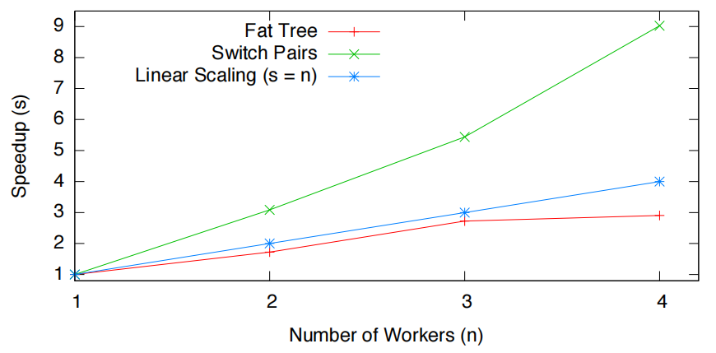
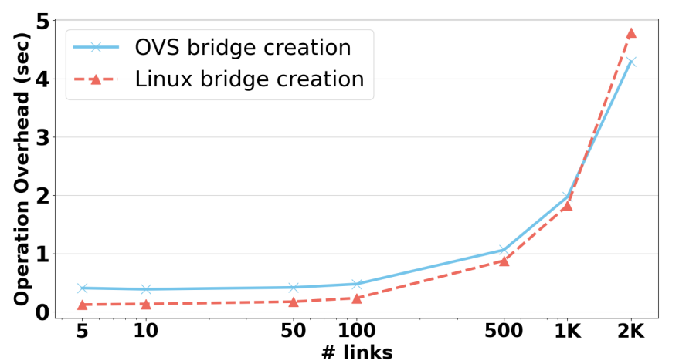
Prior works: Multi-machine network emulation
Enhancing scalabiilty and efficiency, but limited by cross-machine networks
Scalability gain bottlenecks
Limited emulation scale
Scalability gain bottlenecks
cross-machine bw./delay bottleneck
Virtual networks ≤10K nodes
or
Efficiency gain bottleneck
Limited construction speed
Efficiency gain bottleneck
Slow cross-machine link construction
hours to construct 10K-node virtual networks
[1]
[2]
[1] Philip Wette, M Dräxler, Arne Schwabe, F Wallaschek, M Zahraee, and H Karl. 2014. MaxiNet: Distributed emulation of software-defined networks. 2014 IFIP Networking Conference, IFIP Networking 2014, 1–9. https://doi.org/10.1109/IFIPNetworking.2014.6857078
[2] Zhaoyu Gao, Anubhavnidhi Abhashkumar, Zhen Sun, Weirong Jiang, and Yi Wang. 2025. Crescent: Emulating Heterogeneous Production Network at Scale. In 21st USENIX Symposium on Networked Systems Design and Implementation (NSDI 24). USENIX Association, Santa Clara, CA, 1045–1062. https://www.usenix.org/conference/nsdi24/presentation/gao-zhaoyu
Notes:
To do this, many prior works use multi-machine for network emulation. This indeed helps, but has limitation because of cross-machine communication bottlenecks like delay and bandwidth contention, limiting the effect of multi-machine solutions.

Slide 7
New path: single-machine emulation framework
Goal: Fast construction of large-scale virtual networks using a single machine
Work of this paper:
Systematic analysis on two OS kernel bottlenecks
SplitNN: addresses the bottlenecks with multi-VM splitting and multi-netns splitting
Performance:
Reducing VN construction time-cost by 98.9%–99.2%
Achieving minute-level (1-5 mins) construction of 10K-node virtual networks
Notes:
On the other hand, we take a different path. We aim at building large-scale virtual network within a single machine.
We analyze kernel-level bottlenecks of current emulators, and introduce SplitNN—a new single-machine architecture based on multi-VM splitting and multi-netns splitting.
With this, we reduce construction time by about 99.2%, and can construct ten-thousand-node virtual networks within just several minutes.

Slide 8
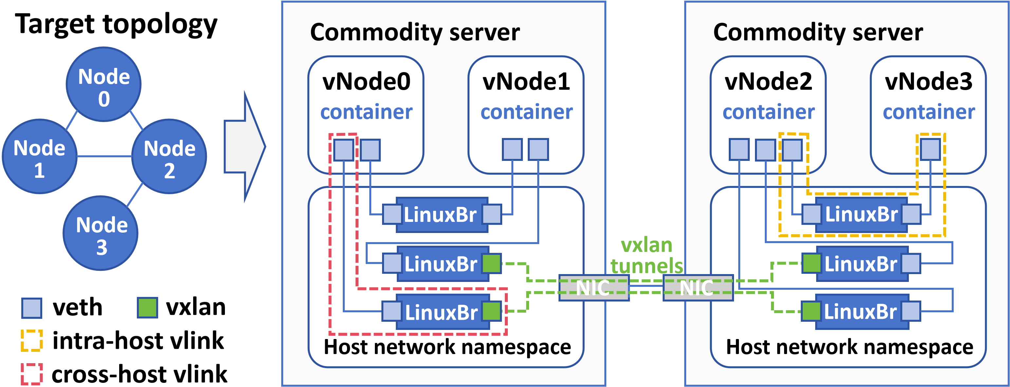
Virtual Network Construction
Virtual network structure
Backbone namespace (BBNS): the netns that carries backend virtual devices of vlinks
SOTA architecture: Uni-BBNS architecture (mostly on bare-metal)
Two-staged construction
Stage 1: vnode constuction
Stage 2: vlink constuction
with Linux netlink APIs
Notes:
Now let’s review some background. Constructing a virtual network involves two stages:
At first, the virtual nodes, or we call vnodes, are created as containers;
then, the virtual links, or we call vlinks, are constructed by virtual devices like veth, bridges, and VXLANs
These virtual devices are created with linux netlink APIs
The backend virtual devices are put in into a network namespace, which we call the backbone namespaces, or BBNS.
In state-of-the-art emulators, all vlinks are carried in a single BBNS—usually the host namespace. We call this architecture as uni-BBNS.
In addition, most emulators are deployed on bare-metal.

Slide 9
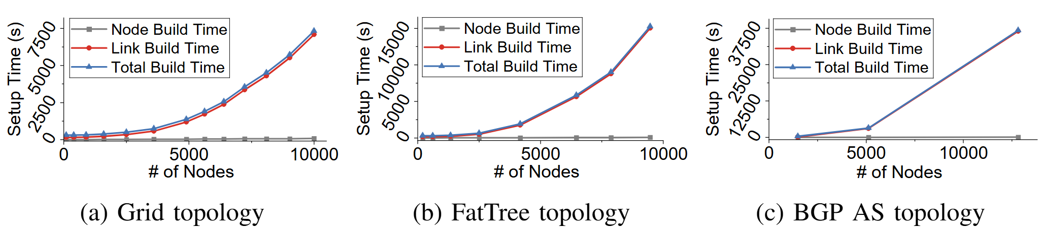
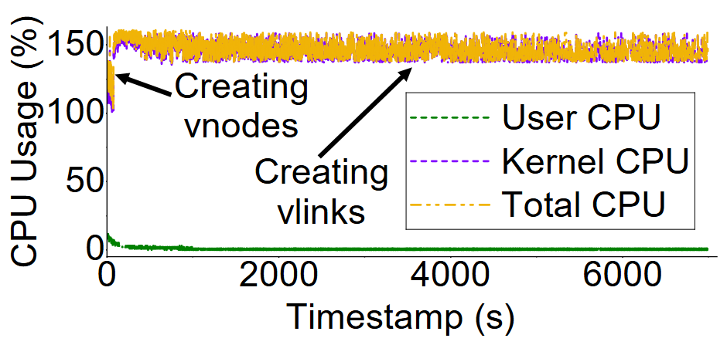
Problem: High VN Construction Time-cost
Profiling results with uni-BBNS architecture on bare-metal:
Superlinear scaling time-cost with network size
Hour-level construction time-cost of 10K-node topologies
Vlink construction dominates total time-cost
Kernel-state CPU domonates total CPU overhead
Bottleneck: OS kernel processing during vlink construction
Notes:
Then we profiled this uni-BBNS approach on bare metal. We find virtual network construction time increases superlinearly with topology size. And over 99% of CPU usage is spent in kernel state during vlink construction. Why? We found two limitations from OS kernel.

Slide 10

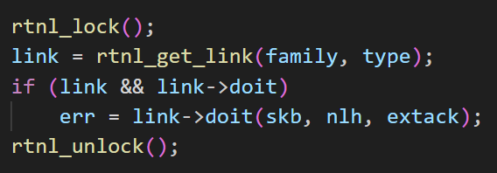
Kernel Limitations
Limitation1: Serialization of vlink construction
netlink API requests are synchroinzed with kernel global lock
Vlink0 construction
Vlink1 construction
netlink API rtnl_lock
In-kernel critical section
(modification of virtual devicers)
Notes:
First, Linux kernel forces virtual link construction to be serialized.
Linux uses a global lock (the rtnl_lock shown here) to synchronize netlink API calls.
This prohibits virtual link construction from parallel acceleration.

Slide 11
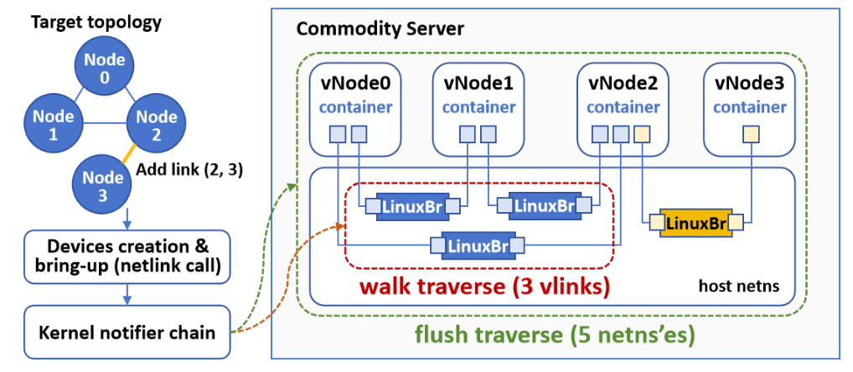
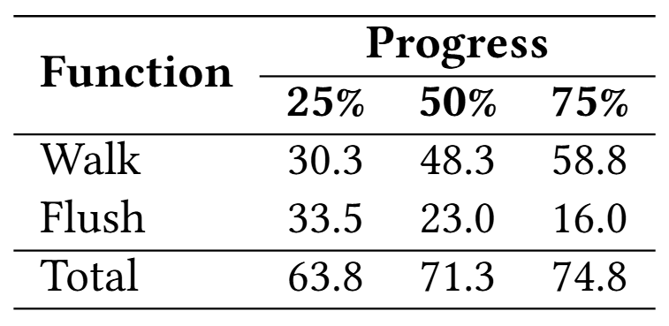
Kernel Limitations
Limitation2: High overhead from the kernel notifier chain
Each vlink construciton triggers:
flush (wireless_nlevent_flush): traverse all netns’es in the system
walk (fib6_walk): traverse all existing vlinks in the netns where the vlink being constructed is located
CPU overhead of walk and flush
Notes:
The second kernel limitation is the High overhead from the kernel notifier chain
Each vlink triggers two costly kernel notifier functions: flush and walk
The flush function traverses all network namespaces in the system, and the walk function, scans all virtual links in the backbone.
In large-scale emulation, these traversal need to scan many many elements and therefore become costly.

Slide 12
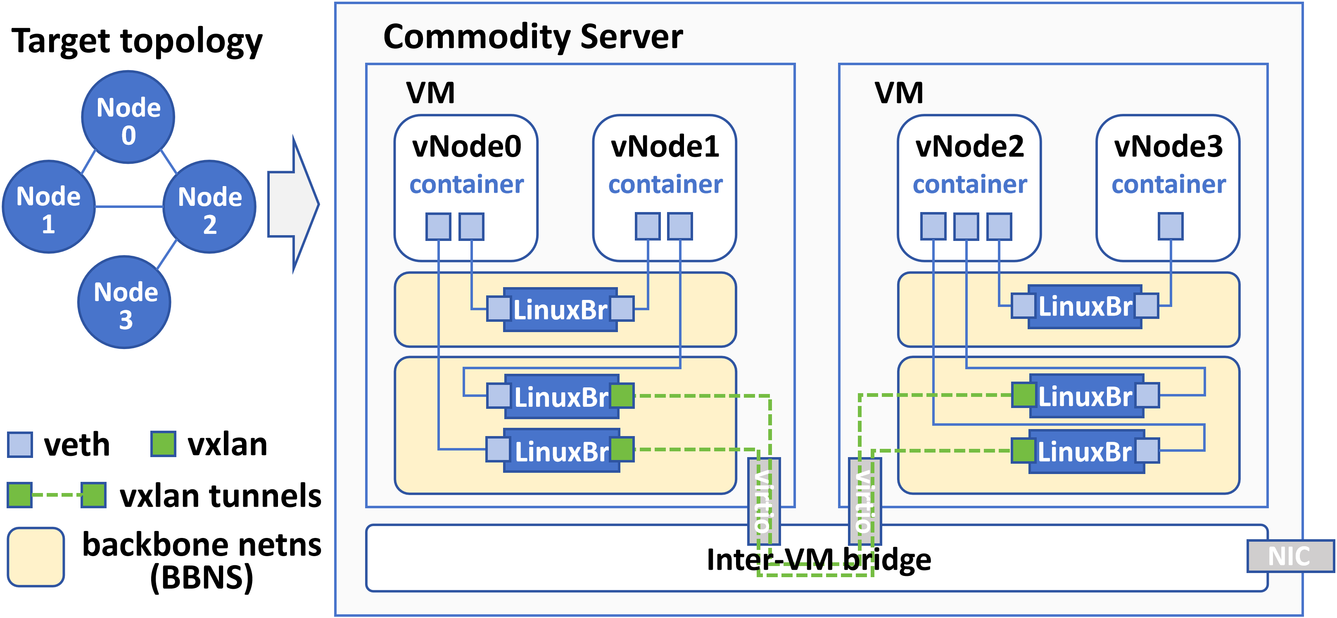
Our Solutions
Kernel limitations
Solution
SplitNN
Serialization
Multi-VM Splitting
Kernel notifier chain
Multi-netns Splitting
Notes:
To address the two kernel-level limitations, we propose SplitNN architecture, which comprises two core mechanisms:
multi-virtual machine splitting, and multi-network namespace splitting

Slide 13
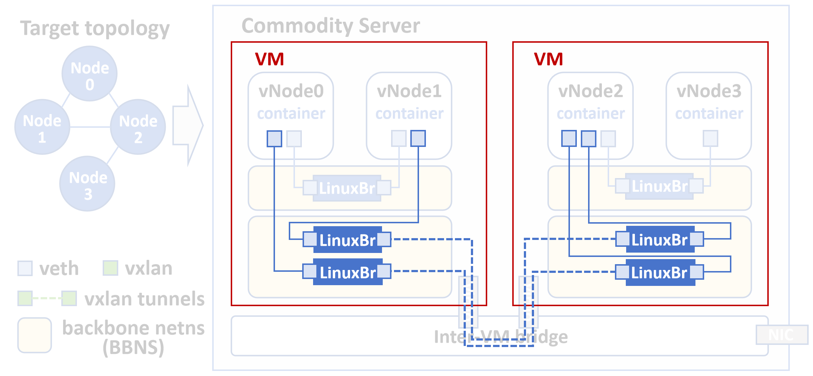
Multi-VM Splitting
Speedup by using multiple VMs to construct sub-VNs in parallel
Notes:
The first is multi-VM splitting. On a single machine, we setup multiple virtual machines.
For each emulation experiment, we partitions the input topology into sub-topology, each run as a sub-virtual network in a separate virtual machine.
This parallelizes virtual link construction on a physical machine with multiple kernel instances.

Slide 14
Multi-VM Splitting
Problem: How many VMs to use?
Idea: Trade-off between time-cost reduction and memory overhead
Lower virtual network construction time
# of VM increases
Increasing Memory overhead
Solution:
Use an empirical value (4 VMs) through experimentation (shown behind)
Notes:
But there’s a trade-off: more VMs reduce time but increase memory usage.
In this paper, we use an empirical value. Through experiments, we find that 4 VMs strike a good balance in our environment.

Slide 15
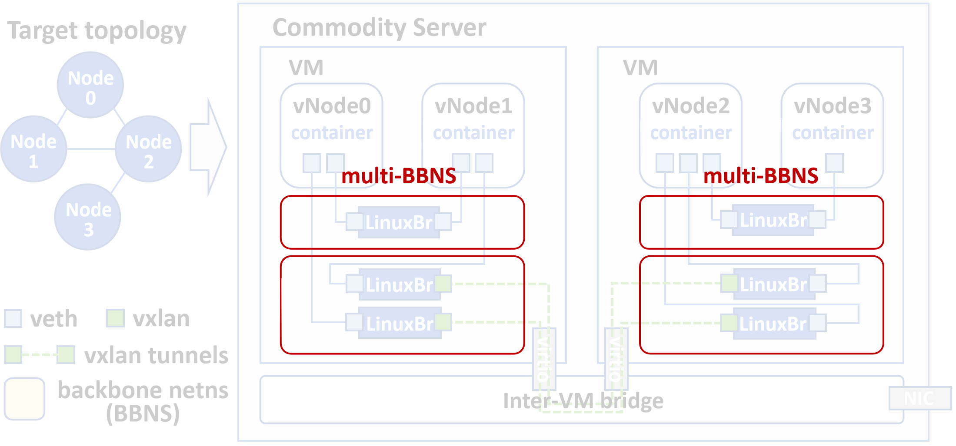
Multi-netns Splitting
Distribute vlinks into multiple BBNSes within each VM
# of Vlinks per BBNS decreases
Reducing walk (device traversal in a BBNS) kernel notifier function overhead
Notes:
The second mechanism of SplitNN is multi-netns splitting, which distributes virtual links across multiple backbone namespaces.
This greatly reduces virtual link count in each backbone namespaces, and therefore greatly reduces the device traversal overhead caused by the kernel notifier “walk”.

Slide 16
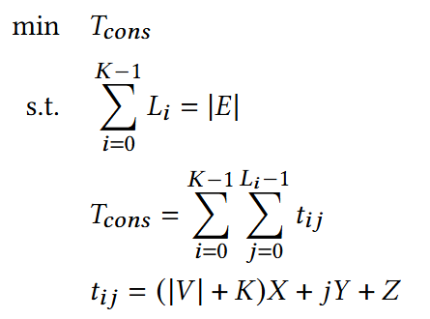
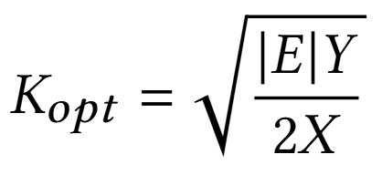
Multi-netns Splitting
Problem: How many backbone namespaces to use?
Idea: Trade-off between reduced walk overhead and increased flush overhead
As BBNS number grows, walk overhead decreases, but flush overhead increases due to increased netns number
Problem formalization
Target: minimize total time-cost of all vlink construction
Solution
For each vlink construction, denote:
(1) 𝑋as the time-cost of traversing a netns;
(2) 𝑌as the time-cost of traversing 3 devices of a pre-existing vlink within the BBNS carrying the vlink;
(3) 𝑍as other constant-level overheads.
The optimal BBNS number
Per-vlink construction time-cost
Notes:
But again, a trade-off problem comes when we decide how many backbone namespaces to use.
As BBNS number grows, walk overhead decreases, but flush overhead increases due to increased network namespace number.
we need to balance these benefits and overhead by finding an optimal backbone namespace count.
To find the best backbone namespace number, we formalize an optimization problem.
We model the total time-cost as a function w.r.t. X, Y, and Z, which correspond to flush, walk, and other overhead for each virtual link construction.
The solution can be derived as here.

Slide 17
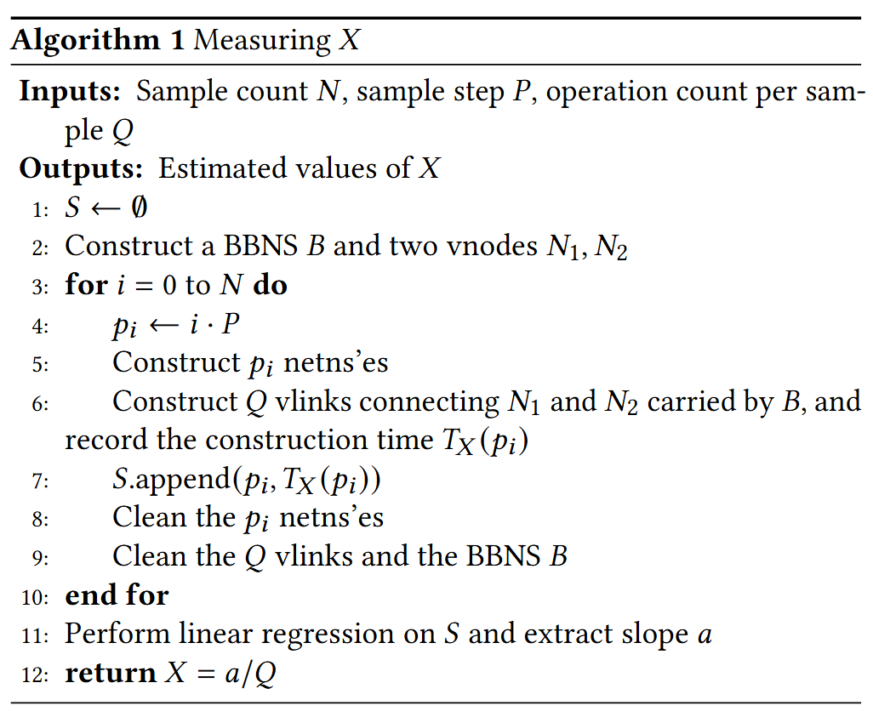
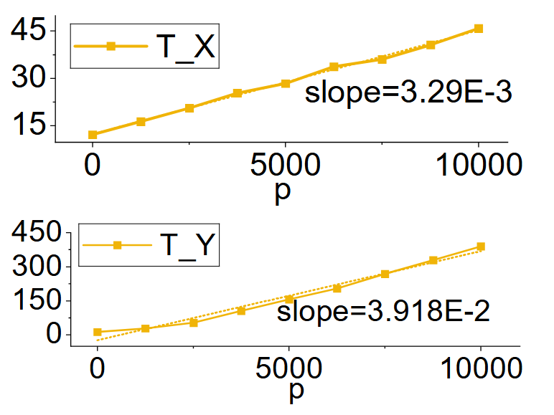
Measuring Hyperparameter Values
The values of X and Y need to be measured
Measuring method: sampling and regression
Notes:
Finally, the values of hyperparameters X and Y mentioned before need to be measured.
We propose a sampling and regression workflow to measure them on a given platform, and derive the X Y values as shown here.

Slide 18
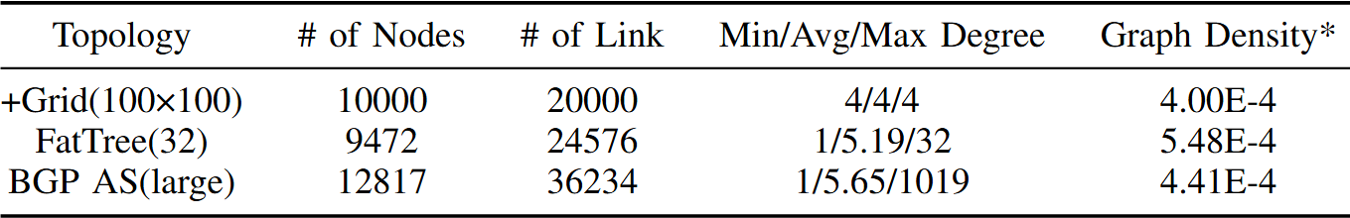
Experiment Setup
Hardware Setup
AMD EPYC 7742 (2.2GHz, 128 cores)
768GB DRAM
Software Setup
Physical server runs Linux 5.4.0 and KVM
VM runs Linux 6.10.8
Golang 1.22.8 for netlink API calls
Build containers with the FRRouting image
Topologies (Typical large-scale networks in real-world, 10K node level)
Notes:
Now onto the evaluation. Our experimental environments are shown here.
We evaluate SplitNN with +Grid, FatTree, and real-world BGP Autonomous System topologies, each with around ten thousand nodes.

Slide 19
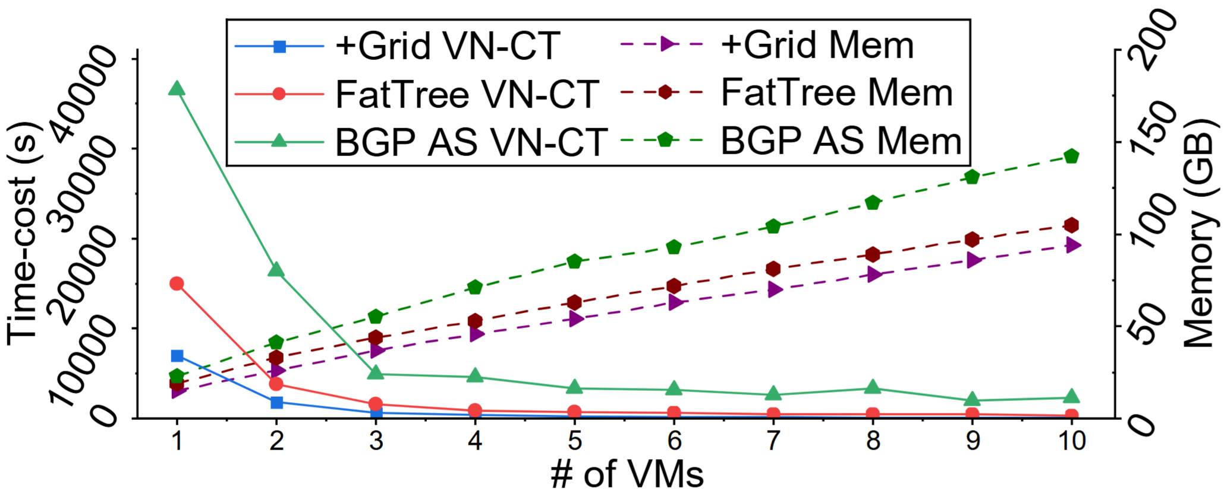
Evaluation of Multi-VM splitting
Good performance but limited scalability
With 4-VM splitting
Topology | Time-cost (min) | Reduction
+Grid(100×100) | 6 | 94.9%
FatTree(32) | 15 | 94.0%
BGP AS (large) | 75 | 87.6%
Still not reaching the minute-level goal
Notes:
First, we evaluate multi-VM splitting independently.
We can see that as number of VM increases, the virtual network construction time-cost drastically reduces, but gain diminishes with over 4 VMs
With 4 VMs, memory overhead is controlled, and +Grid and FatTree are constructed with near minute-level time-cost (6-15 minutes).
But the denser BGP AS topology needs 75 minutes, still not reaching the minute level goal.

Slide 20
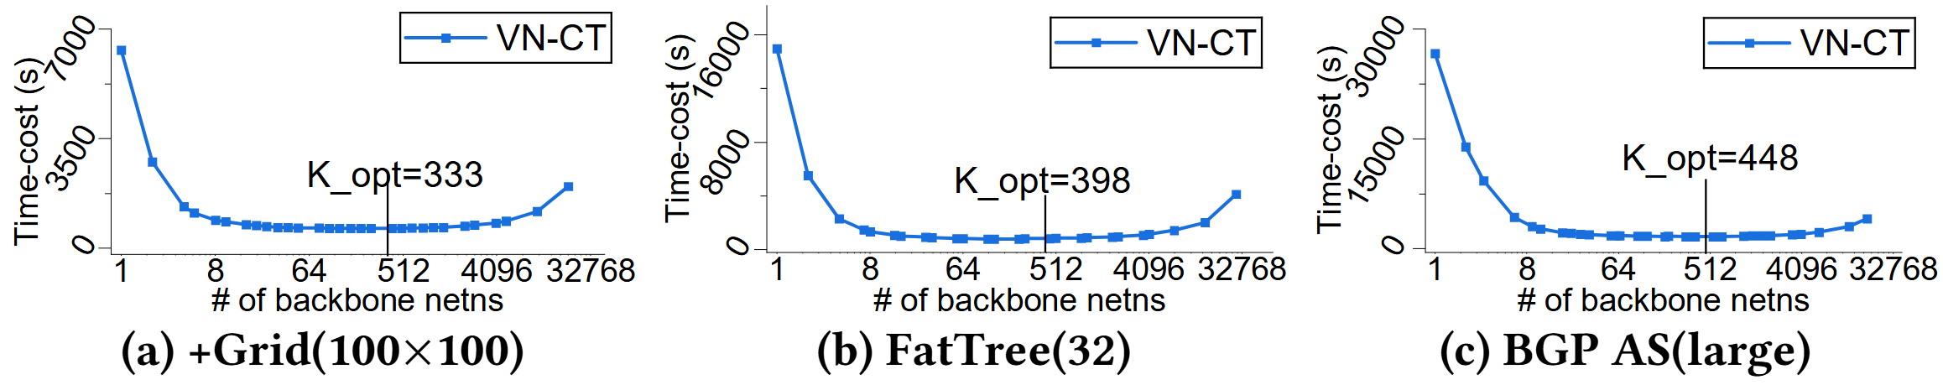
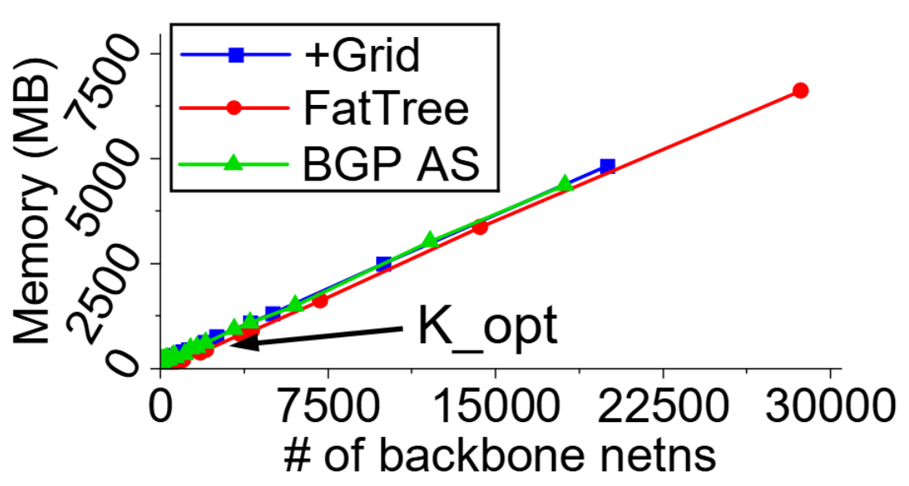
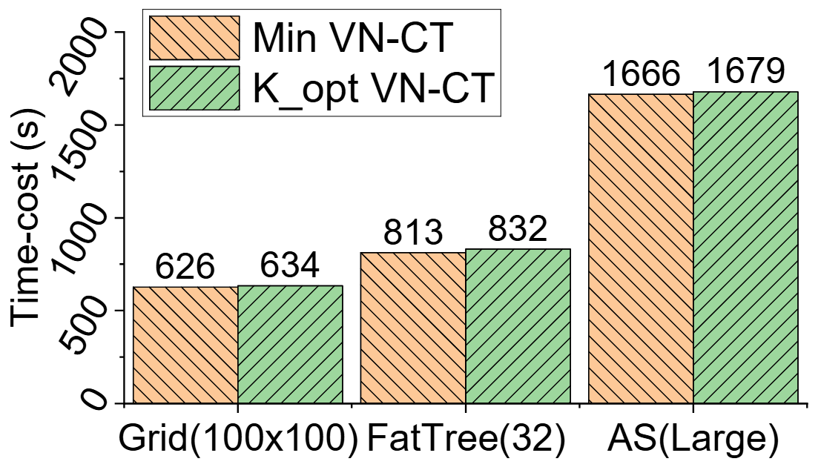
Evaluation of Multi-netns splitting
Great Performance
With K_opt-netns splitting, +Grid and FatTree are constructed near 10 minutes; BGP AS needs ~30 minutes
Great Scalability
Great Correctness
Time-cost under K_opt-netns splitting only differs 0.8%–2.3% with brute-forced mininal time-cost
K_opt BBNS’es only 70-115MB memory overhead
Notes:
Then, we evaluate multi-netns splitting. It shows great performance.
With optimal backbone namespace number, +Grid and FatTree are constructed near 10 minutes; BGP AS needs ~30 minutes.
Also, multiple backbone namespaces consumes very memory, which shows the great scalability of using multi-netns splitting.

Slide 21
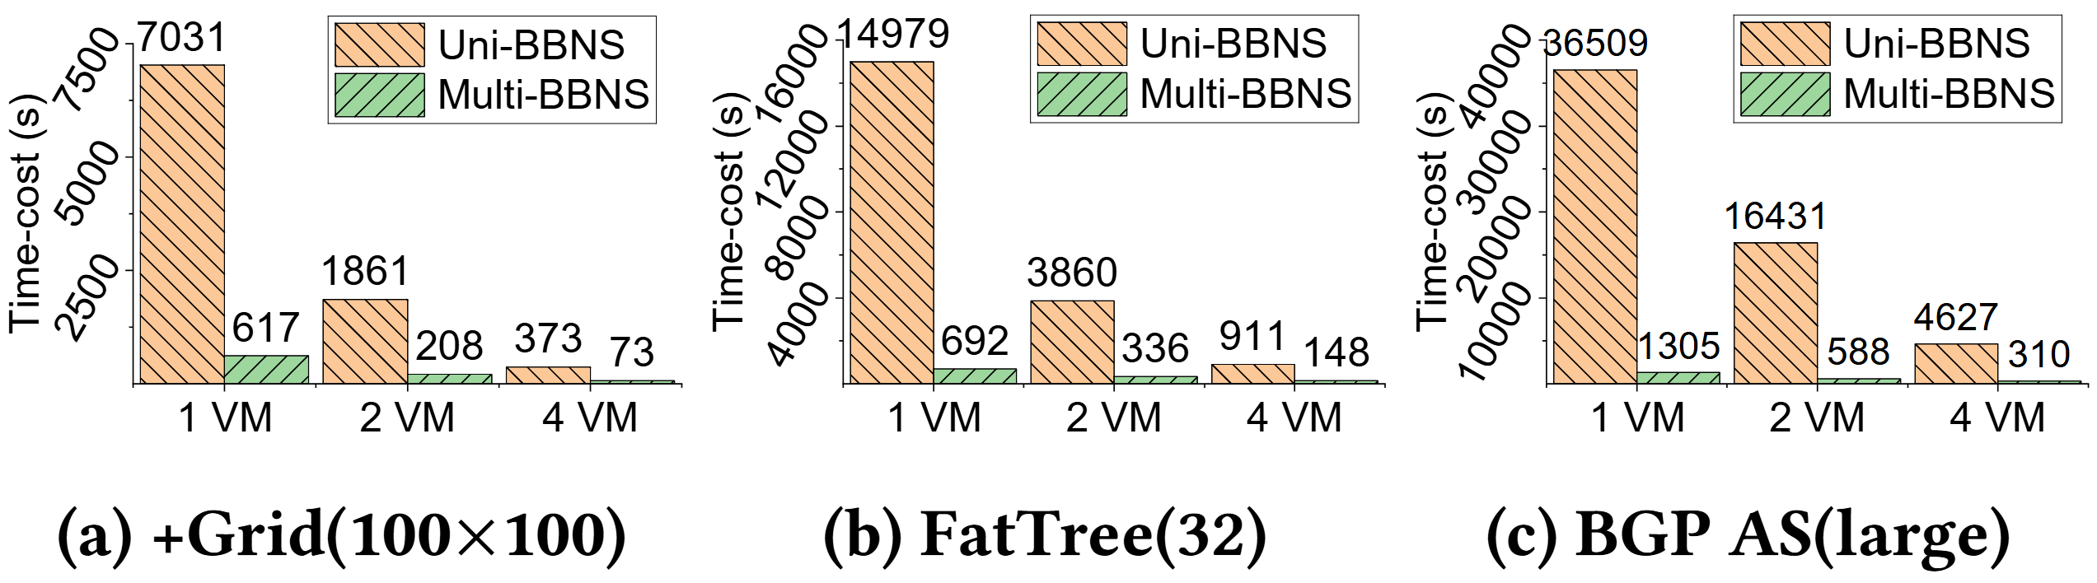
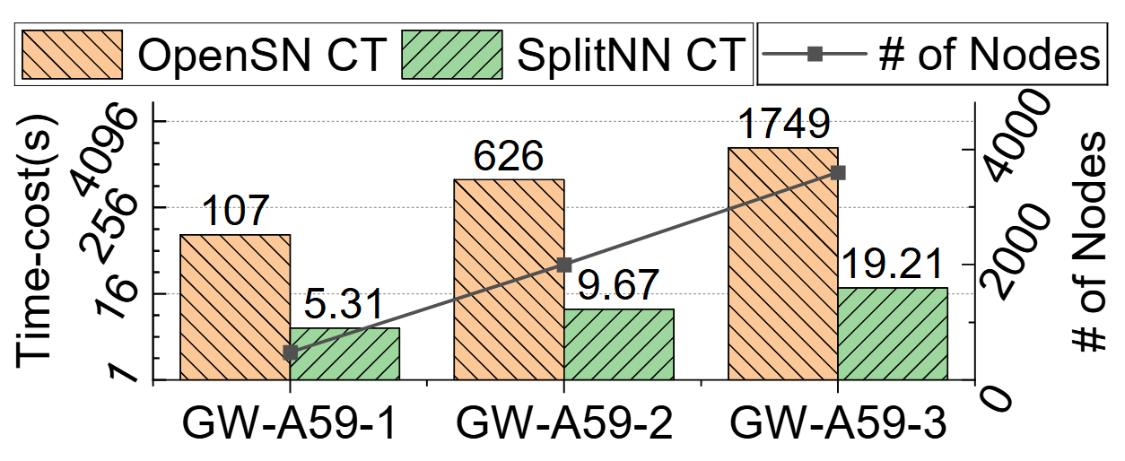
Evaluation of SplitNN
Comparison with SOTA architecture
Comparison with OpenSN
Baseline: UniBBNS on bare-metal architecture
OpenSN: A SOTA LEO satellite network emulator
98.9%–99.2% time-cost reduction
+Grid: ~1 min; FatTree: ~2 min; BGP AS: ~5 min
Test with GW-A59 contellation topologies
95.0%–98.9% time-cost reduction
SplitNN is performant, achieving our goal of minute-level construction of 10K-node virtual network
[1] Wenhao Lu, Zhiyuan Wang, Shan Zhang, Qingkai Meng, and Hongbin Luo. 2025. OpenSN: An Open Source Library for Emulating LEO Satellite Networks. In Proceedings of the 8th Asia-Pacific Workshop on Networking (Sydney, Australia) (APNet ’24). Association for Computing Machinery, New York, NY, USA, 149–155. https://doi.org/10.1145/3663408.3663430
Notes:
Finally, when multi-virtual machine splitting and multi-network namespace splitting meet together, we get our expected results.
With 4 VMs and optimal number of BBNSes, we achieve our goal to construct ten-thousand-node virtual networks within several minutes across all three topologies.
We also compare SplitNN with OpenSN, a state-of-the-art satellite network emulator from last year APNet. For the same topologies, SplitNN is 20x faster, cutting construction time by up to 98.9%.
These experiments prove SplitNN’s great performance in large-scale network emulation.

Slide 22
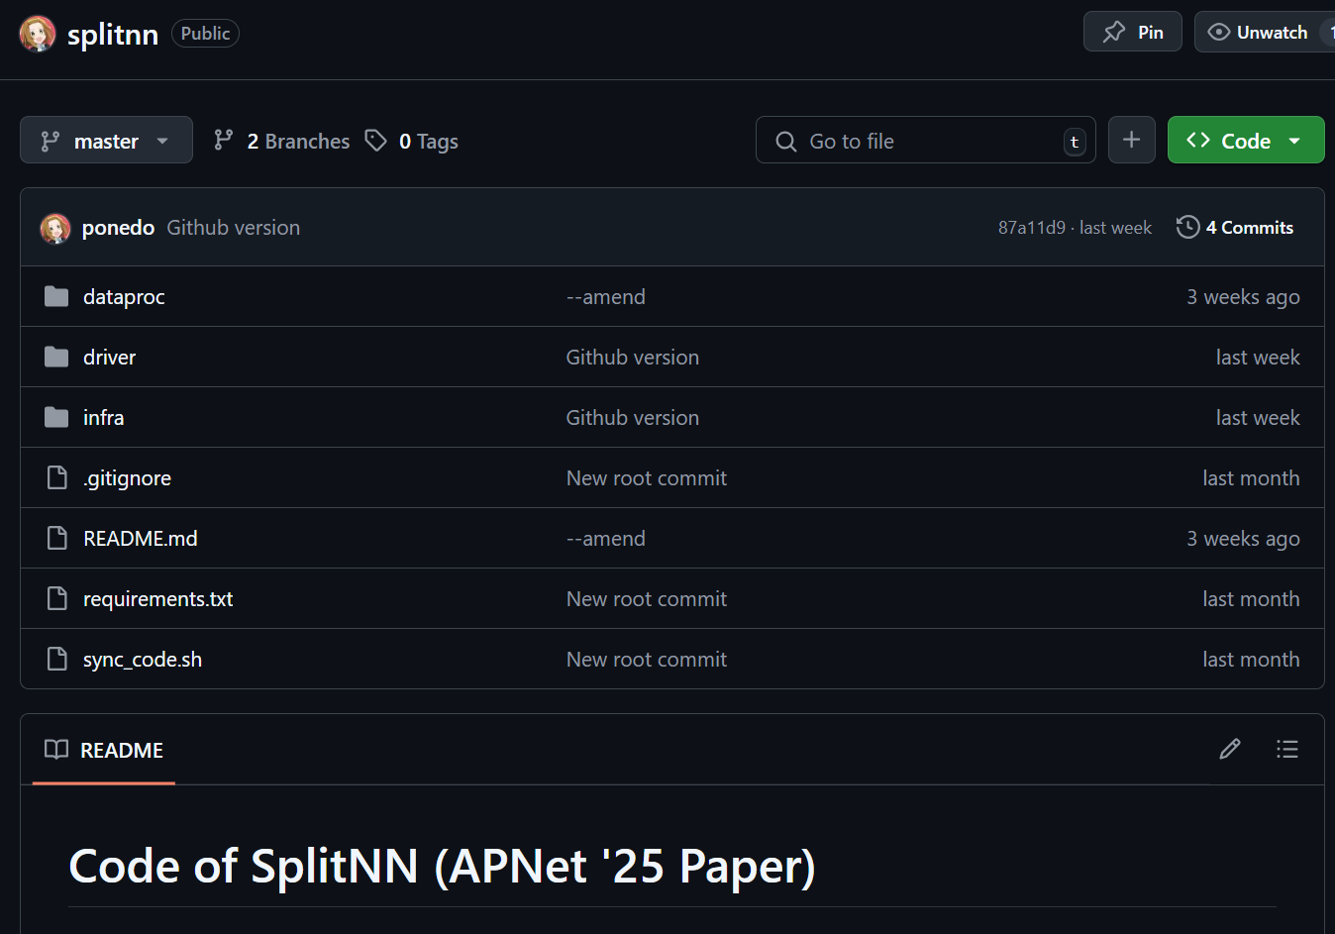
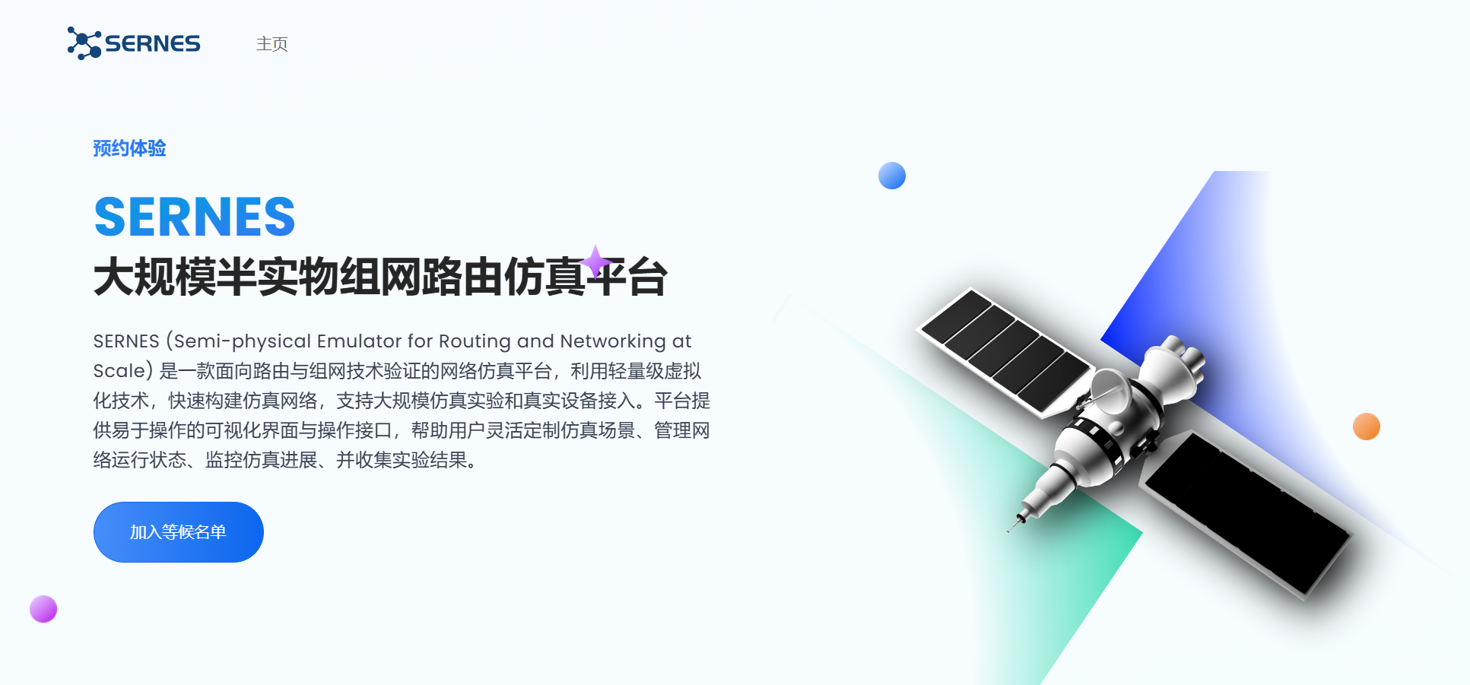

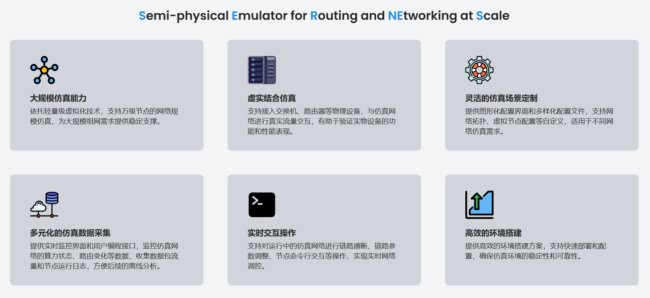

Thank you for listenling
Our public resources
Experiment Code
Emulation Platform
www.sernes.cn
https://github.com/ponedo/splitnn
Contact us
Corresponding authors:
Yanbiao Li: lybmath@cnic.cn
Gaogang Xie: xie@cnic.cn
Kaifei Peng: pengkaifei@cnic.cn
Notes:
That’s all. Thank you for listening. Here we list some public resource, including a public platform we built for large-scale network emulation. We welcome users and cooperators from public, and now we are happy to take questions.

